Slide 1

Spring Boot

Slide 2
Prerequisites for learning Spring Boot
Before learning Spring Boot, you must have the basic knowledge of Spring Framework.

Slide 3
What’s Spring Boot?
It is a Spring module which provides RAD (Rapid Application Development) feature to Spring framework.
It is used to create stand alone spring based application that you can just run because it needs very little spring configuration.
Spring Boot does not generate code and there is absolutely no requirement for XML configuration.
Spring makes java application development easier.
Spring Boot makes spring development easier.

Slide 4
Advantages of Spring Boot
Create stand-alone Spring applications that can be started using java -jar.
Embed Tomcat, Jetty or Undertow directly. You don't need to deploy WAR files.
It provides opinionated 'starter' POMs to simplify your Maven configuration.
It automatically configure Spring whenever possible.
It provides production-ready features such as metrics, health checks and externalized configuration.
Absolutely no code generation and no requirement for XML configuration.

Slide 5
Prerequisite of Spring Boot
To create a Spring Boot application following are the prerequisites.
Java 1.8
Maven 3.0+ or Gradle 2.3+
Spring Framework 5.0.0.BUILD-SNAPSHOT
An IDE (Spring Tool Suit) is recommended.

Slide 6
Spring Boot Features
Web Development
SpringApplication
Application events and listeners
Admin features
Externalized Configuration
Properties Files
YAML Support
Type-safe Configuration
Logging
Security

Slide 7
Web Development
It is well suited Spring module for web application development. We can easily create a self-contained HTTP server using embedded Tomcat, Jetty or Undertow. We can use the spring-boot- starter-web module to start and running application quickly.
SpringApplication
It is a class which provides the convenient way to bootstrap a spring application which can be started from main method. You can call start your application just by calling a static run() method.
public static void main(String[] args){
SpringApplication.run(className.class, args);
}
Application Events and Listeners
Spring Boot uses events to handle variety of tasks. It allows us to create factories file that are used to add listeners. we can refer it by using ApplicationListener key.
Always create factories file in META-INF folder like: META-INF/spring.factories

Slide 8
Admin Support
Spring Boot provides the facility to enable admin related features for the application. It is used to access and manage application remotely. We can enable it by simply using spring.application.admin.enabled property.
Externalized Configuration
Spring Boot allows us to externalize our configuration so that we can work with the same application in different environments. Application use YAML files to externalize configuration.
Properties Files
Spring Boot provides rich set of Application Properties. So, we can use that in properties file of our project. Properties file is used to set properties like: server-port = 8082 and many others. It helps to organize application properties.
YAML Support
It provides convenient way for specifying hierarchical configuration. It is a superset of JSON. The SpringApplication class automatically support YAML. It is successful alternative of properties.

Slide 9
Type-safe Configuration
Strong type-safe configuration is provided to govern and validate the configuration of application. Application configuration is always a crucial task which should be type-safe. We can also use annotation provided by this library.
Logging
Spring Boot uses Common logging for all internal logging. Logging dependencies are managed by default. We should not change logging dependencies, if there is no required customization is needed.
Security
Spring Boot applications are spring bases web applications. So, it is secure by default with basic authentication on all HTTP endpoints. A rich set of Endpoints are available for develop a secure Spring Boot application.

Slide 10
Spring Boot Project
There are multiple approaches to create Spring Boot project. We can use any of the following approach to create application.
Spring Maven Project
Spring Starter Project Wizard
Spring Initializr
Spring Boot CLI – Through command prompt

Slide 11
Spring Boot Application using Spring Initializr

Slide 12
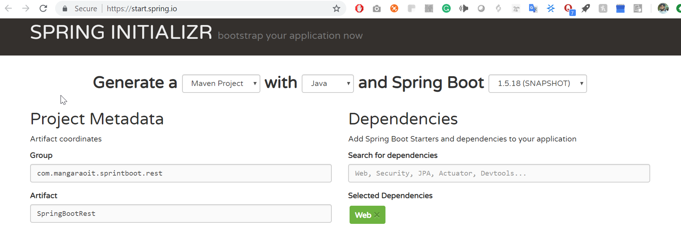
Spring Boot REST Dependencies
Since web services run on the server, apart from Spring Boot we need to add Spring MVC libraries to our project.
Let’s use Spring Initializr to create Spring Boot project. Enter details and click on Generate Project button. Add Web module.

Slide 13
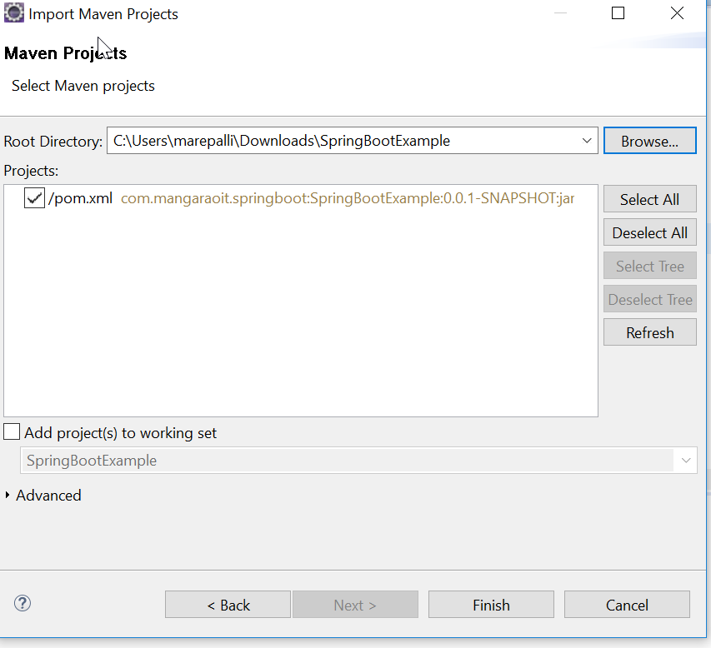
Import the generated Maven project into Eclipse

Slide 14
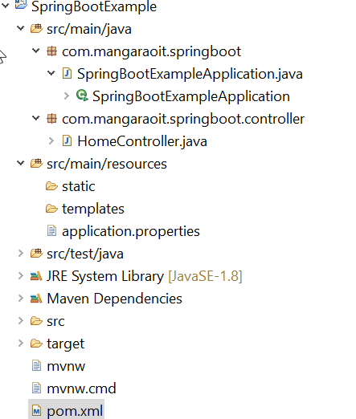
Directory Structure

Slide 15
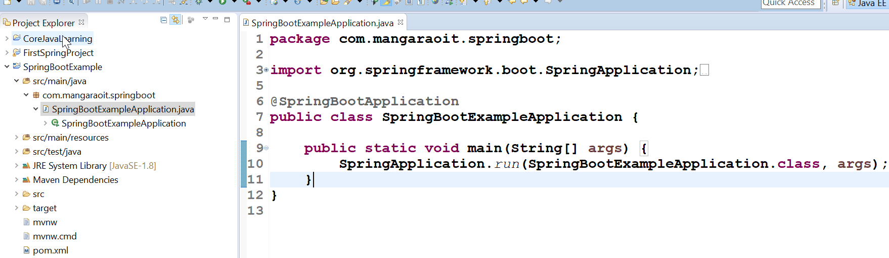
Observe
A pom.xml file that contains all configuration and dependencies information of Spring Boot and MVC.
This project includes a auto created Java file. This Java file provides entry point for the application. It imports classes and uses annotation

Slide 16
Although this application is ready as a stand-alone application and you can start it, we will add a controller to it. So, it can handle HTTP requests.
Create a Controller class
After finishing it, create a method inside the controller which will be called when an HTTP request is made.

Slide 17
HomeController.java
package com.mangaraoit.springboot.controller;
import org.springframework.web.bind.annotation.RequestMapping;
import org.springframework.web.bind.annotation.RestController;
@RestController
public class HomeController {
@RequestMapping("/hello")
public String hello(){
return "Hello, Good Morning";
}
}

Slide 18
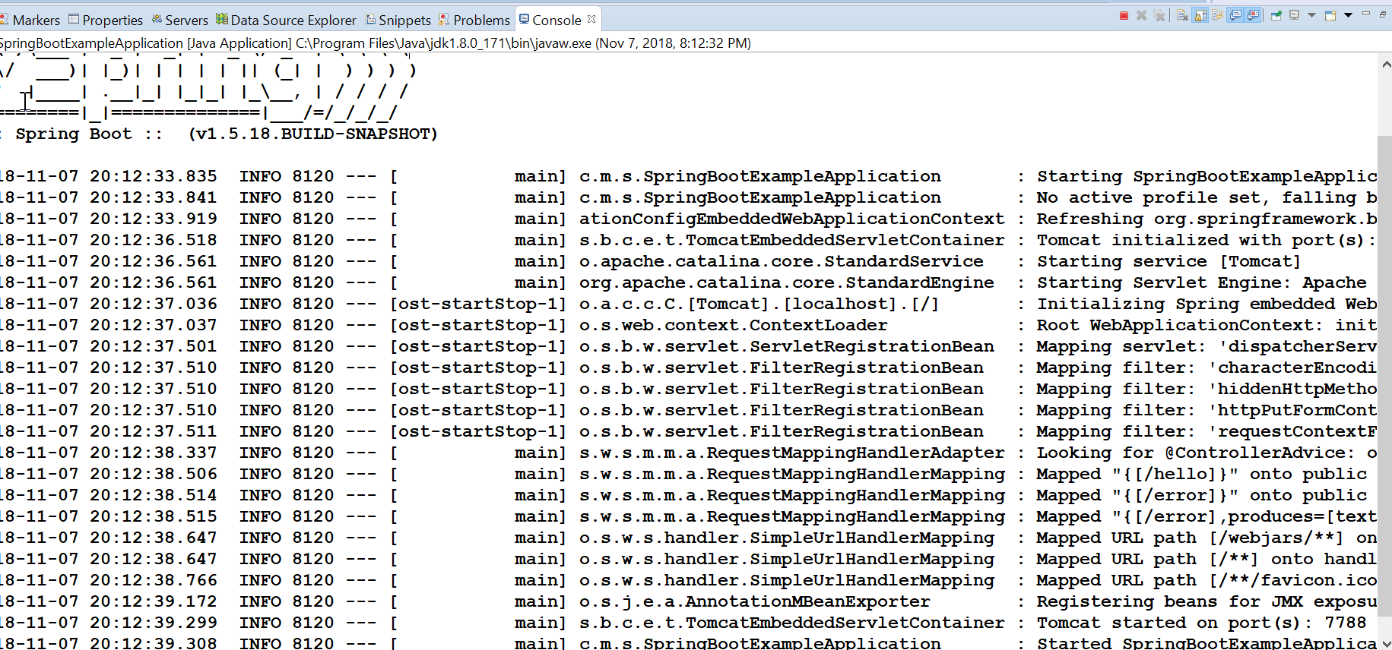
Now, we are running SpringBootExampleApplication.java as a Java application. A snapshot is given below.
During running the application it produce the following output on the console.

Slide 19
How to change port number in spring boot
Open application.properties file and change port no.
Make an entry like below if it doesn’t exist
server.port=9988

Slide 20
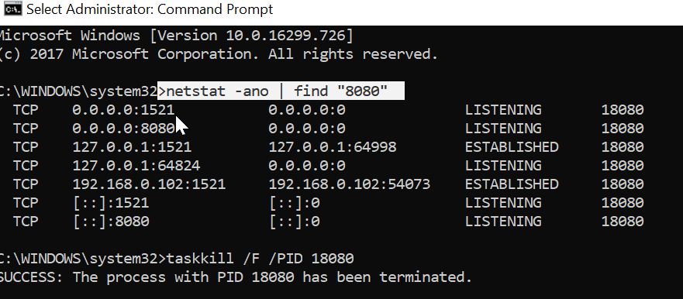
To list all the process running on port 8080 do the following.
Open command prompt in admin mode
netstat -ano | find "8080“
TCP 127.0.0.1:1521 127.0.0.1:64998 ESTABLISHED 18080
TCP [::]:8080 [::]:0 LISTENING 18080
taskkill /F /PID 18080

Slide 21
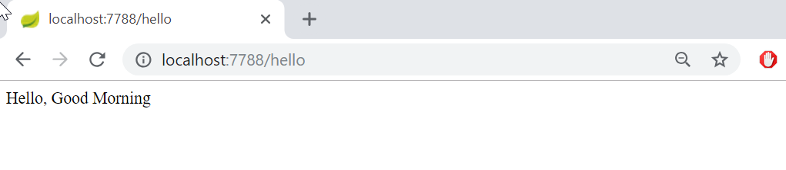
Running on the browser
We are passing /hello request by following the port number. It produces the message returned from the requested method from the controller.

Slide 22
SpringApplicationClass
The SpringApplication, inside the main is a Spring Boot class. It is used to bootstrap our application. It calls static method run() which takes two arguments, one is class type and second is string array. It starts auto-configured tomcat web server when Spring application is started.

Slide 23
Spring Annotations
Note - The @RestController and @RequestMapping annotations are Spring MVC annotations. They are not specific to Spring Boot.

Slide 24
Changing the Java version in pom.xml
we can easily set Java version for our project in the properties section as given below.
<properties>
<java.version>1.8</java.version>
</properties>

Slide 25
Spring Boot Application Properties
Spring Boot provides various properties which can be specified inside our project's application.properties file. These properties have default values and you can set that inside the properties file.
Properties are used to set values like: server-port number, database connection configuration etc.

Slide 26
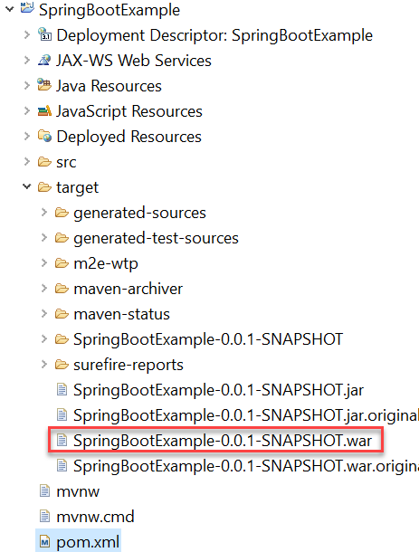
How to create deployable war file in Spring boot
Configure Packaging to WAR
Finally, we tell maven to package the project in to WAR. In your pom.xml, change the attribute value for packaging from jar to war
<packaging>war</packaging>
Then try to build your project using:
mvn package
Find generated war file under target folder.

